Slide 1
Problem Solving

Slide 2
AGENDA & ANNOUNCEMENTS
• UPER Problem Solving Framework
• Solving Problems Using UPER
• A cool story about using Python at work
• I post code snippets and previous module project solutions in my pinned post

Slide 3
Call-by-value vs. reference

Slide 4
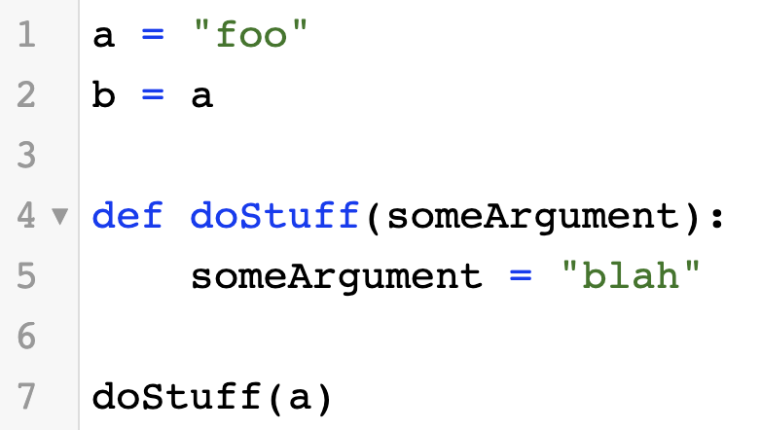
CALL-BY-VALUE VS. REFERENCE
• Very similar to pass-by-value vs. pass-by-reference in other languages
• Immutable objects are call-by-value
• Booleans, Numbers, Strings, Tuples
• Mutable objects are call-by-reference
• Lists, Dictionaries
• More explanation here
a
“foo”
b
“foo”
doStuff
someArgument
“blah”

Slide 5
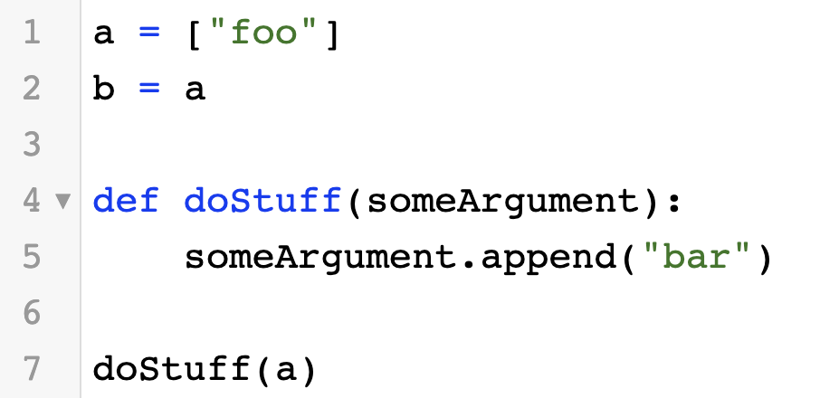
CALL-BY-VALUE vs. REFERENCE
• Very similar to pass-by-value vs. pass-by-reference in other languages
• Immutable objects are call-by-value
• Booleans, Numbers, Strings, Tuples
• Mutable objects are call-by-reference
• Lists, Dictionaries
• More explanation here
a
[“foo”, “bar”]
b
doStuff
someArgument

Slide 6
UPER

Slide 7
UPER
• A general framework for solving problems
• Understand, Plan, Execute, Review
• Very useful for this unit, programming interviews..and your job!

Slide 8
ALGORITHMIC AND DATA STRUCTURE INTERVIEWS
• You’ll definitely encounter algorithmic and data structure interviews during your job search
• Popular outline of an algorithmic/data-structure interview: 5 minute intro, 40-ish minutes of coding (1-2 problems)

Slide 9
WHY USE UPER FOR INTERVIEWS?
• Getting the optimal answer is just one of the many things an interviewer looks for
• They also look for: thought process, testing, spotting bugs, communication skills, coding speed
• UPER allows you to demonstrate this in interviews
• Helps keep you calm during interviews

Slide 10
UNDERSTAND
• Really get to know what the problem is asking for
• Create test-cases: you will use this to convince yourself and the interviewer your answer is correct
• This step could also help you develop a solution
• This step very helpful in CodeSignal, since we have hidden tests

Slide 11
PLAN
• This is usually the part that takes the most time
• What patterns have you seen before that you can apply to the problem?
• What techniques could I use? What data structures can I use? Can I find a better solution? What helper methods do I need?
• Do NOT proceed to the next step unless you know what you’re going to code

Slide 12
EXECUTE
• Code your algorithm!
• If you prepare properly, this should be the easiest/fastest step
• Watch out for bugs

Slide 13
REVIEW
• Give your code a pass through and correct any bugs
• Make sure you don’t cause regressions when fixing your bugs
• Test your code with the test cases you made in the Understand step
• State your runtime and space complexity
• I’ll be talking about this next lecture

Slide 14
Solving Problems Using UPER

Slide 15
NUM GOOD PAIRS
• Return the number of good pairs
• Leetcode Link

Slide 16
RICHEST CUSTOMER WEALTH
• Return the highest wealth of a customer
• Leetcode Link

Slide 17
UNCOMMON WORDS FROM TWO SENTENCES
• Find the uncommon words between two sentences
• Leetcode Link

Slide 18
N-REPEATED ELEMENT IN ARRAY
• Return the n-repeated element in an array/list
• Leetcode Link

Slide 19
KEEP PRACTICING
• The only way to get better at problems is to do more of them
• If you still feel shaky, go to Leetcode and do more problems. The problems in Canvas probably aren’t enough.
• Make sure you practice properly using UPER. Don’t just look at the solution. Memorizing solutions you don’t understand won’t work.
• It’s all about thought process, pattern recall, and applying it to the problem you’re given.

